Slide 1
Smart Surveillance System using Computer Vision

Slide 2
#Team:
Amit Sati
(Testing, Documentation)
Deepankar Sharma
(Coding-Python, CV)
Pawan Chandra
(Documentation , Presentation )

Slide 3
# Proposal:
The basic idea is to make Surveillance system “smart” by applying the Computer Vision Techniques to automatically generate alerts in case of mishaps like burglary so that one doesn’t need to physically monitor the cam feeds.

Slide 4
# Technology:
Python (Coding)
OpenCV (Computer Vision)
Django/Streamlit/Flask (Backend)
MQTT / Firebase (realtime feed to user)
Twilio API (Alerts)

Slide 5

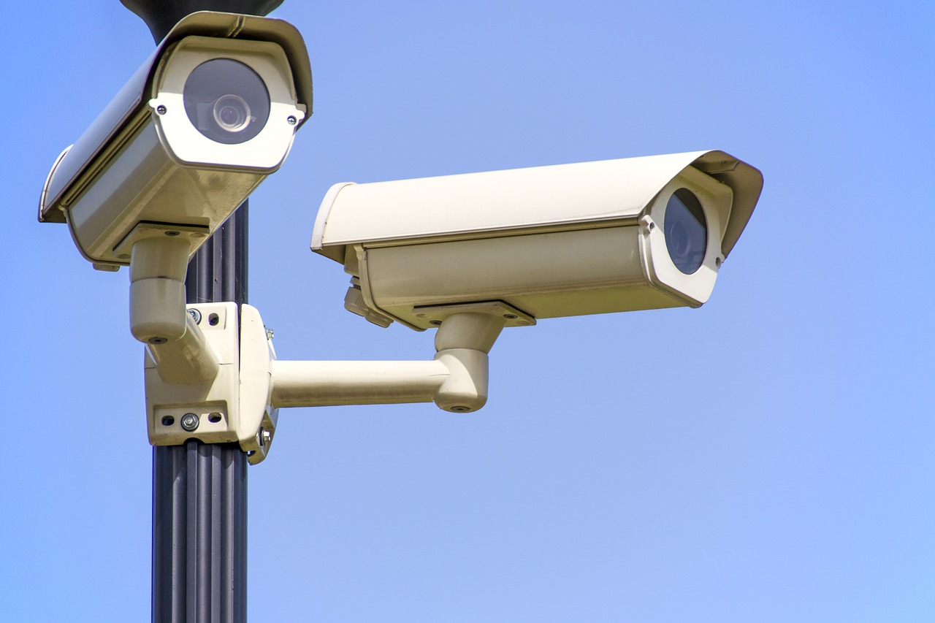

# Overview:
Here our model will do some processing !!!!!
Bro , there’s theif in the house !!!!

Slide 6
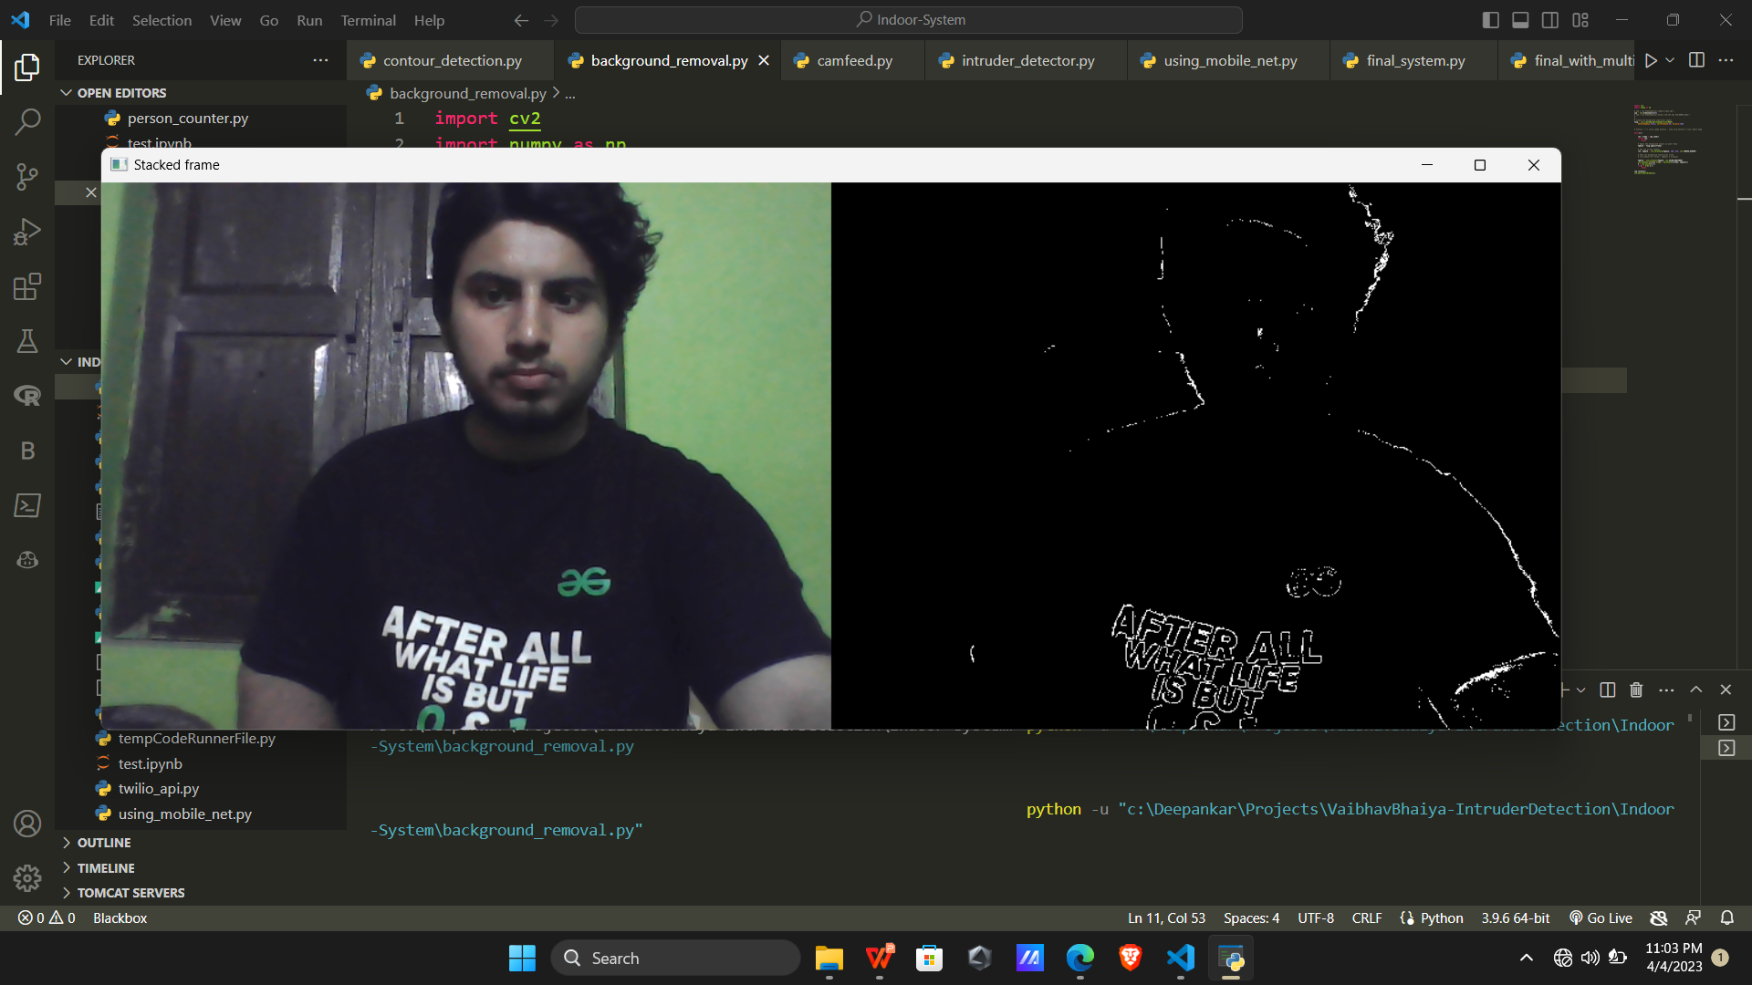
# Progress: Motion Detection via Background Subtraction

Slide 7
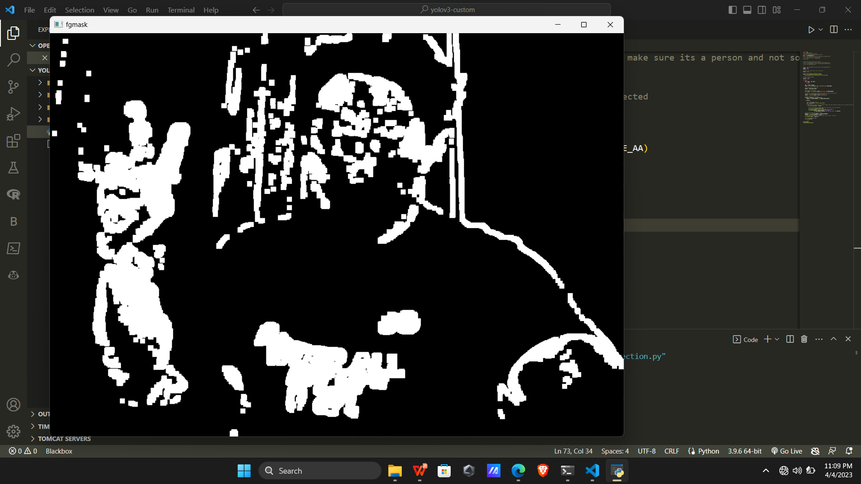
# Progress: Countour Plotting

Slide 8
Computational Efficiency Faster Processing Effective at a certain height, when people are of size of contours
Why Contours......

Slide 9
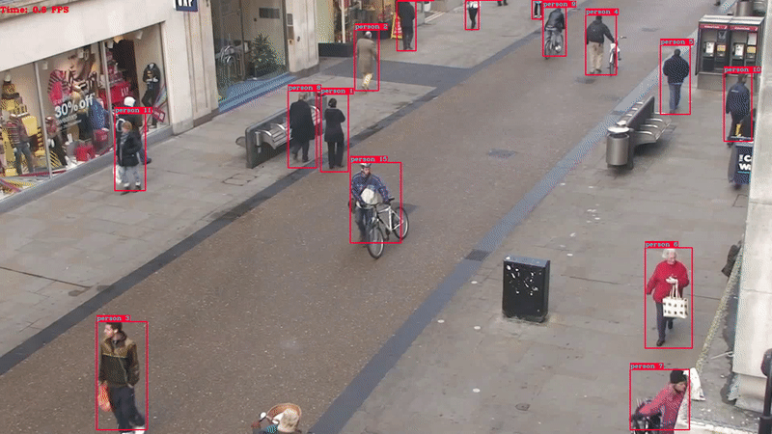
Pipelined yolo v3 people tracking
Only Motion Detection?

Slide 10
Thank You !!

